Slide 1


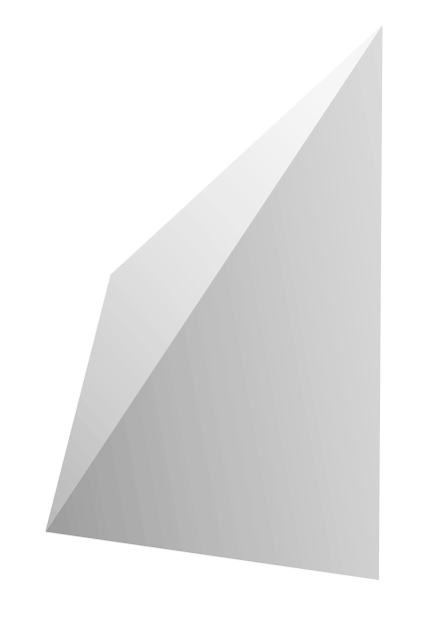
3D Design

Slide 2
I decided to do 3d printing because I had switched from the IT academy to the EMR (Engineering) academy and thought it would relate more to what I was gonna be doing next year than coding.

Slide 3
I worked my way through around six lessons of 3d design, and this is what I’ve learned

Slide 4

Introduction
3d Printing is a process of creation wherein a design or model is input into a special printer that prints it out 3-dimensionally using special materials.

Slide 5
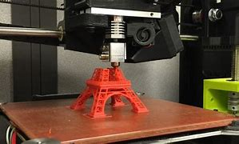
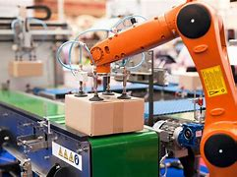
Importance
It allows for improved processes for a variety of things,
such as:
Housing
Manufacturing
Convenience
Sustainability
Cost
Ease
Creativity

Slide 6
Manufacturing

Slide 7
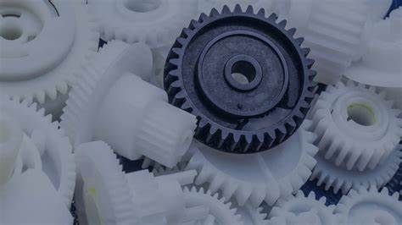
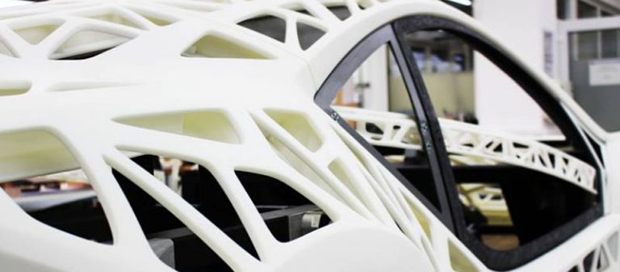
Can create things for large scale productions (factories) such as:
Automobile Parts(L) 3D Printed Parts(R)

Slide 8
Alternatives

Slide 9
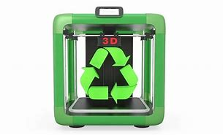
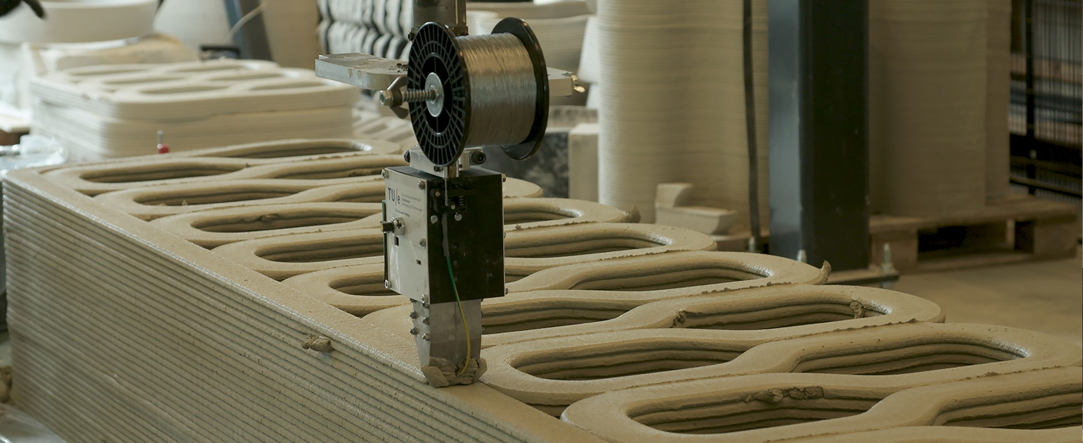
Can result in more sustainable production of goods through things like:
3D Printed Home(L)
Encouraging Reuse, and therefore, Sustainability (R)

Slide 10
Convenience

Slide 11
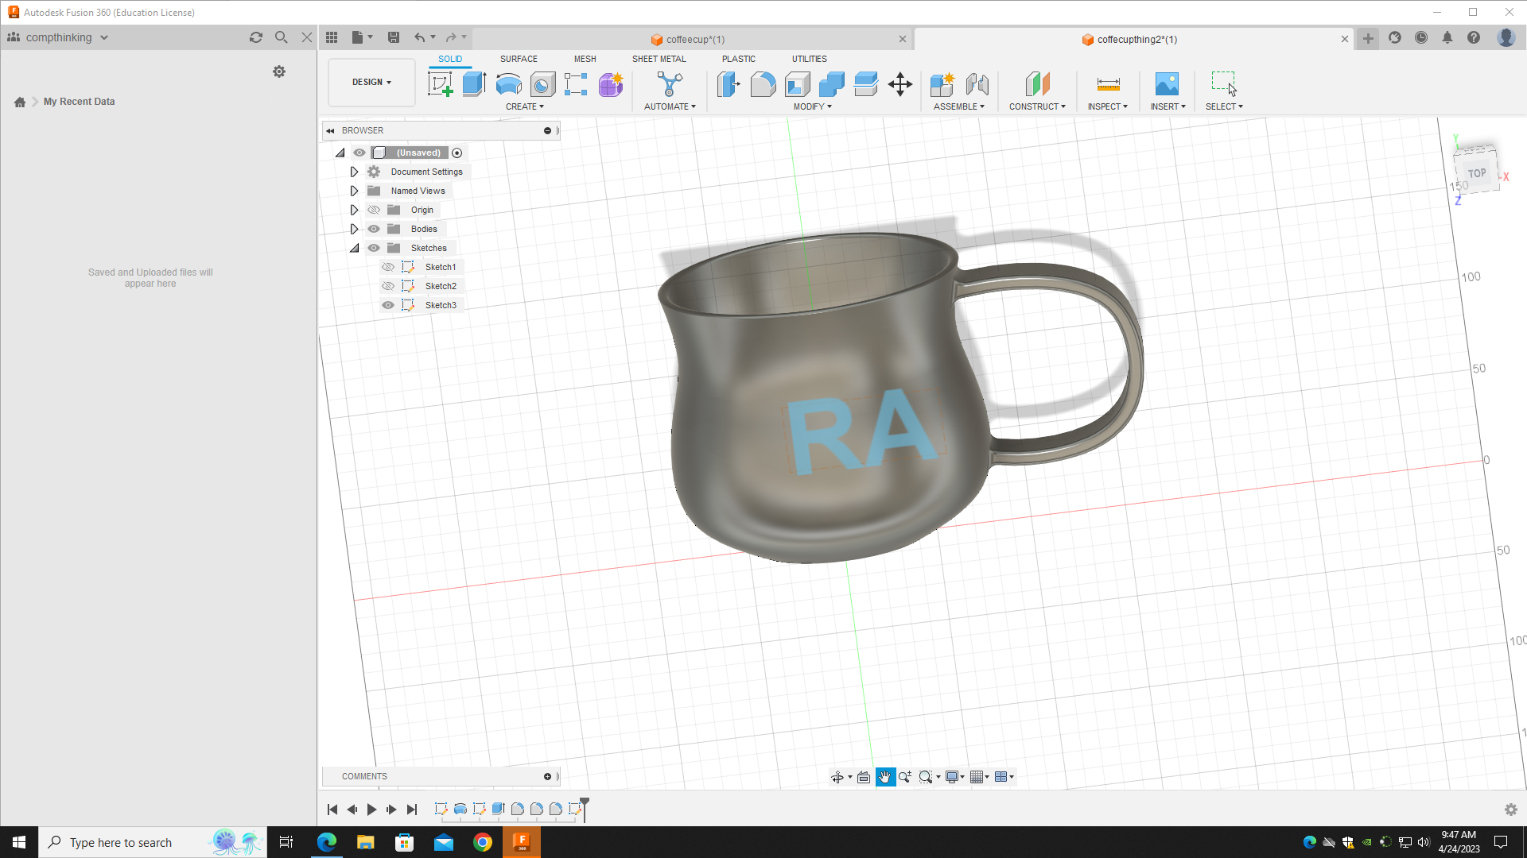
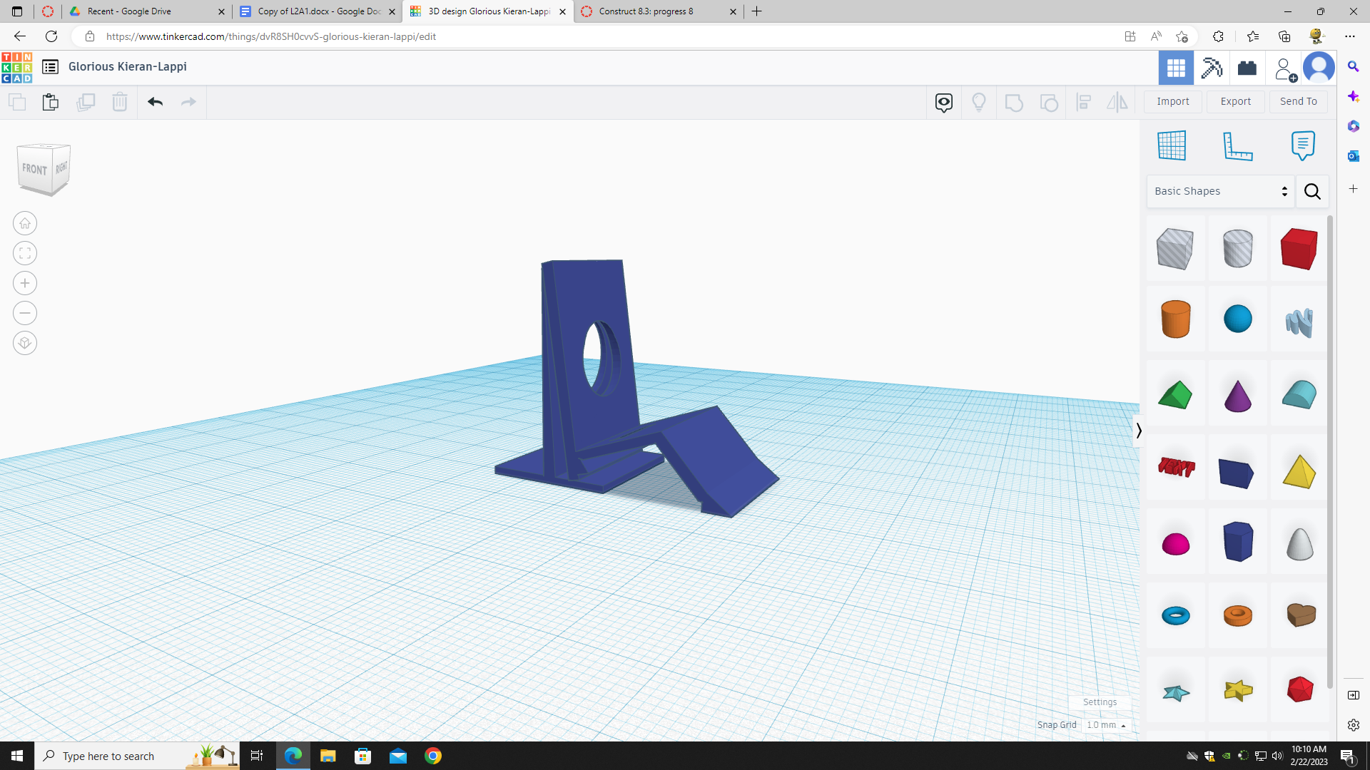
Can create convenient objects to make everyday life easier such as:
Coffee mug (L) Phone Stand (R)

Slide 12
These are just some applications; the possibilities are endless

Slide 13
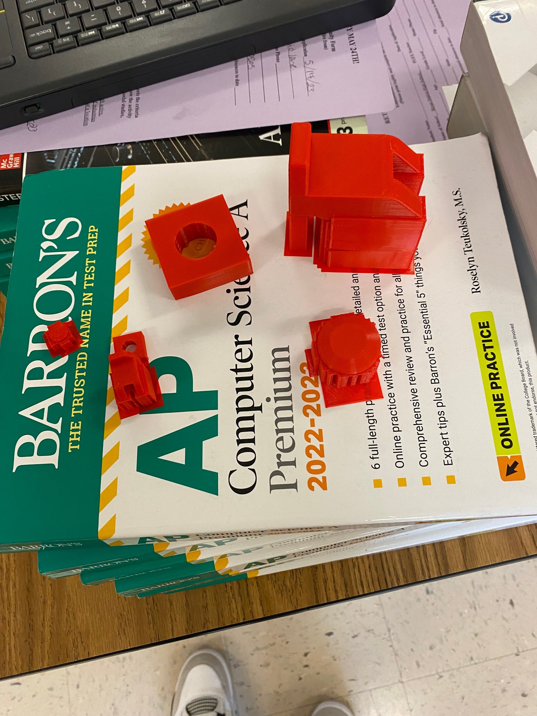
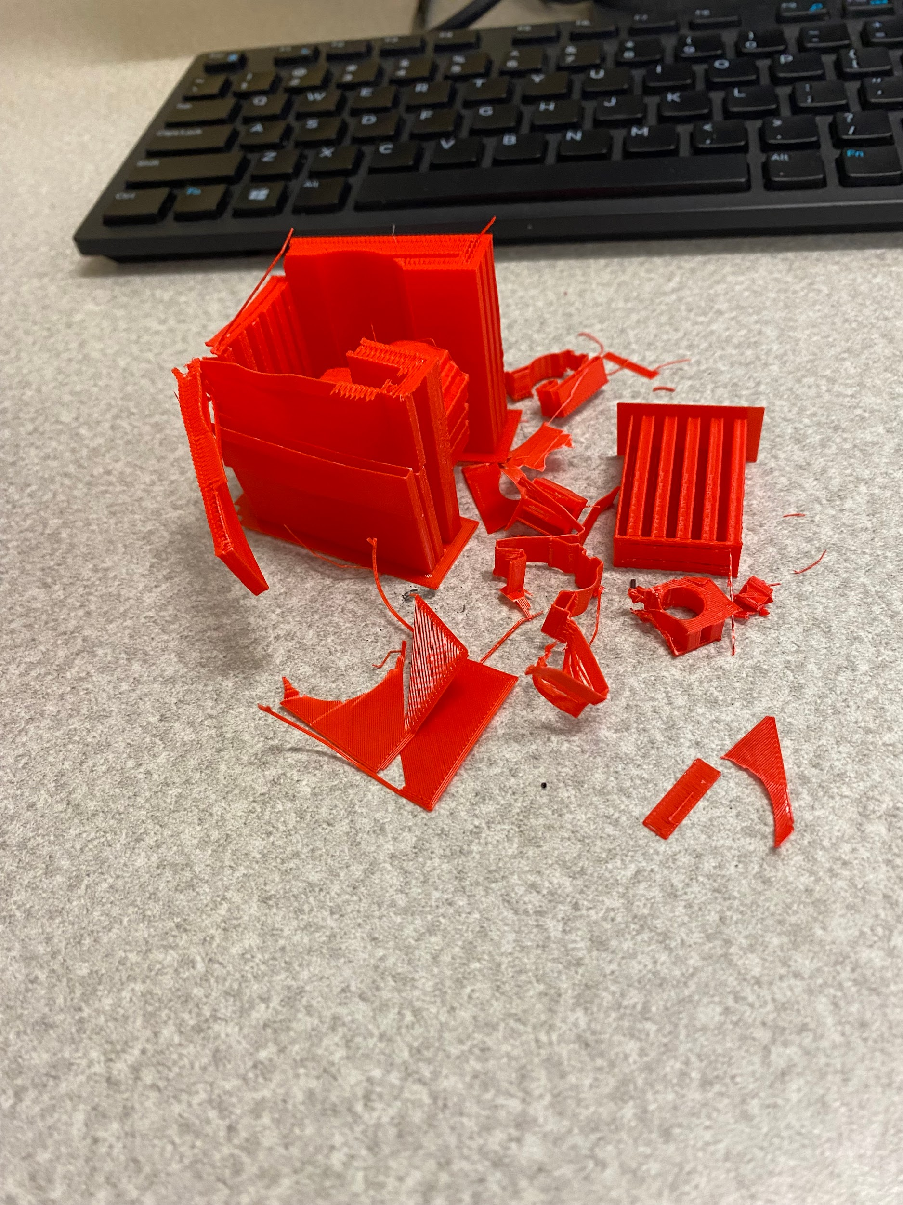
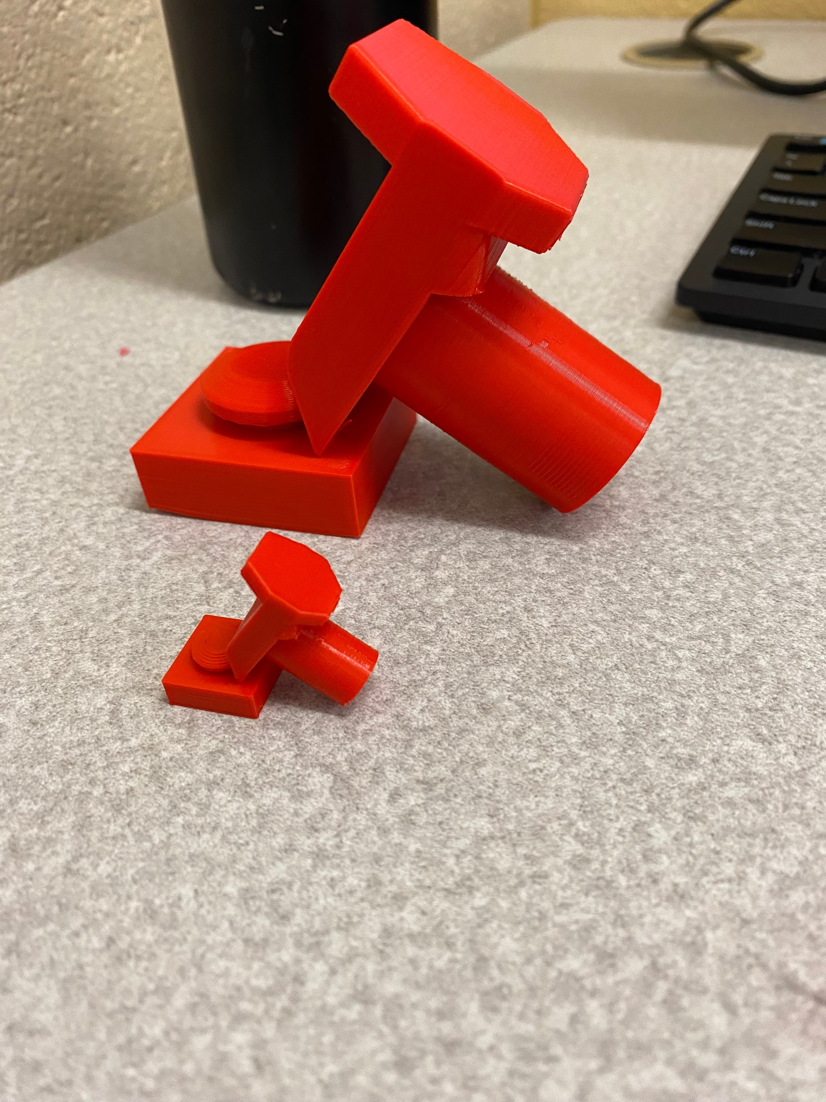
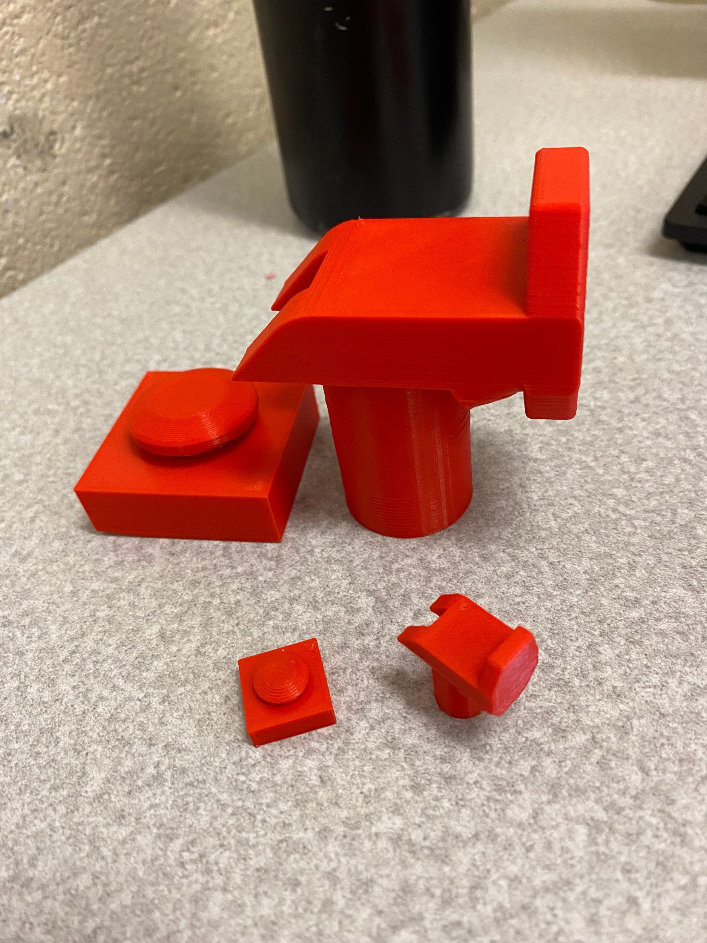
My Creations
Off The Printer
(Top Left)
Tearaway Supports (Top Right)
Finished Products (Hammer and Nail)

Slide 14
In total, I spent a good couple of classes on it, but it really wasn’t too bad time-wise, the most daunting thing was getting the programs to work, which took the most time for me.

Slide 15

I recommend learning about 3d design because it is unique and will likely be important in the future!

Slide 16
THANKS!
Do you have any questions?
youremail@freepik.com
+91 620 421 838
yourcompany.com
Please keep this slide for attribution

